Slide 1
Instance Segmentation
Zhiyang Liu, Yaofei Wang, Huaiyu Zheng

Slide 2
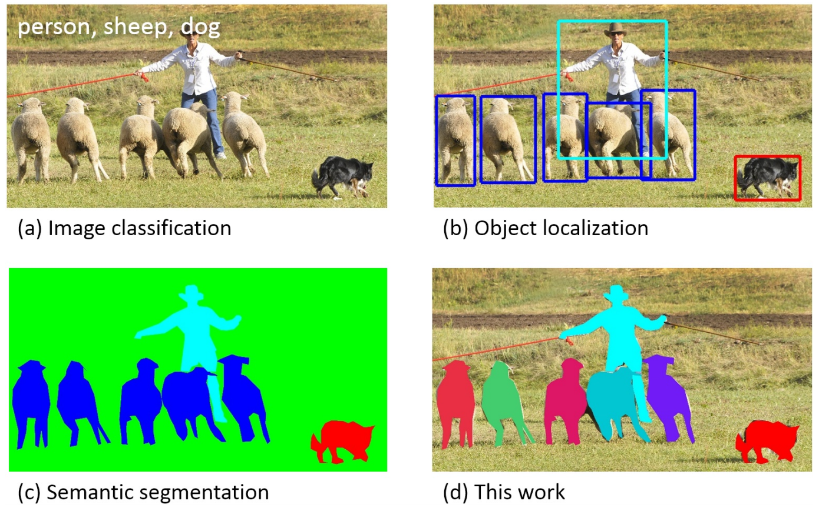
Instance Segmentation
Classification：Only label
Object Detection: Label and bbox
Semantic Segmentation: pixel mask

Slide 4
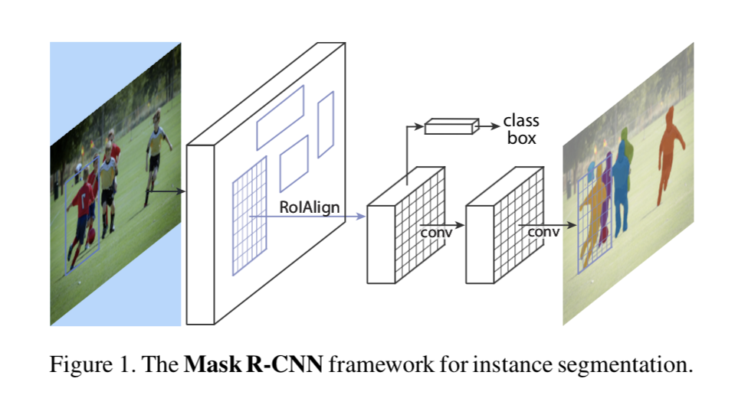
There are two categories of methods
for instance segmentation.
Proposal-based methods: developed from object detection (FCIS, Mask R-CNN)
Notes:
FCIS: Fully Convolutional Instance-aware Semantic Segmentation

Slide 5
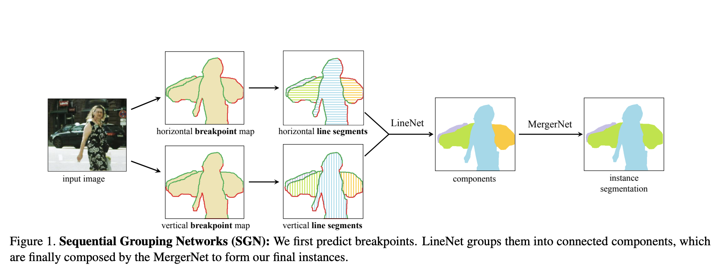
There are two categories of methods
for instance segmentation.
Proposal-free methods: cluster pixels into instances based on semantic segmentation results (SGN)

Slide 6
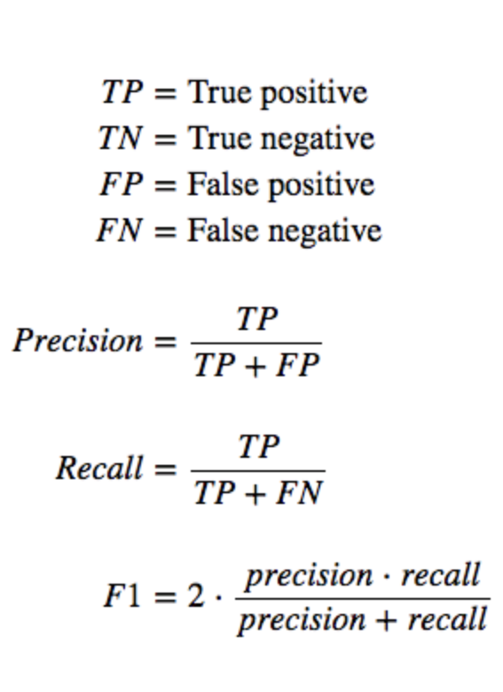
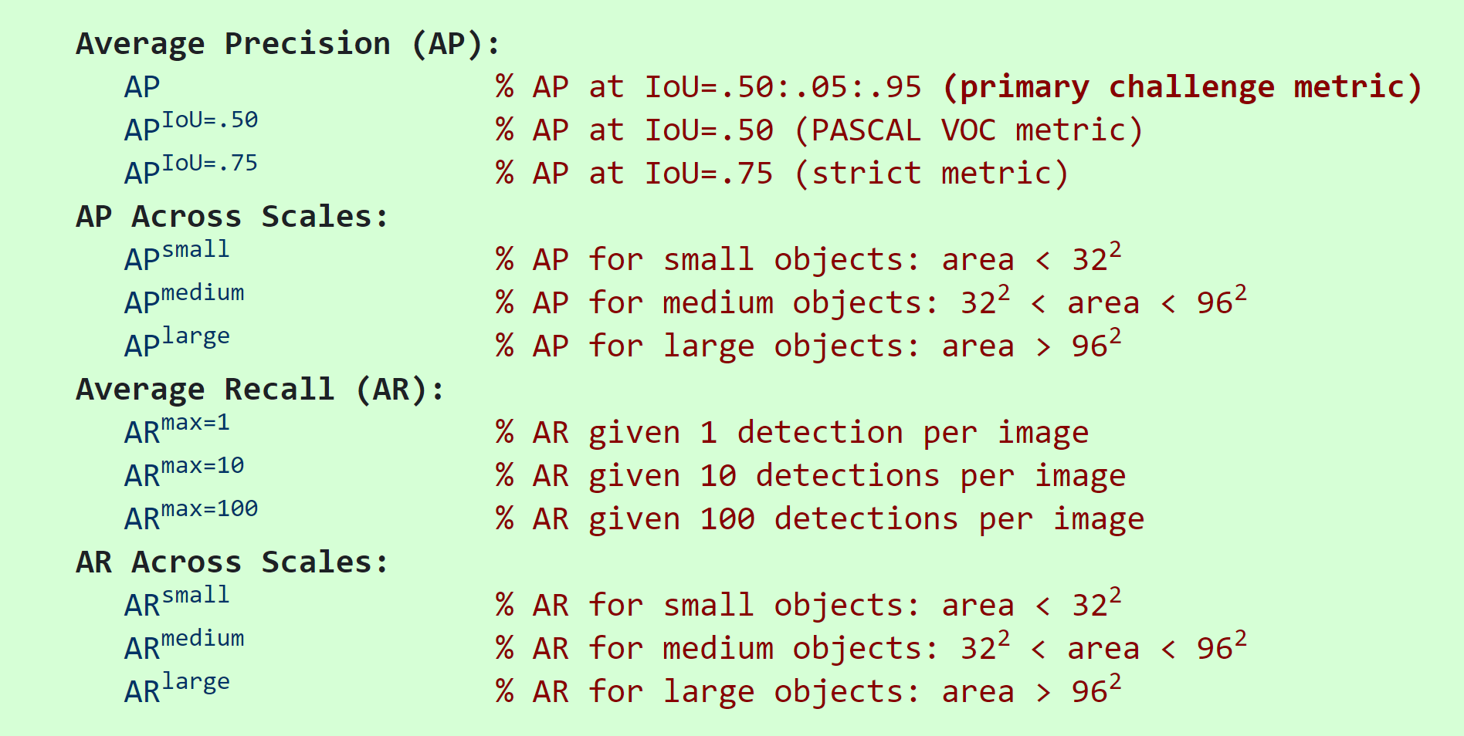
Evaluation Metric

Slide 7
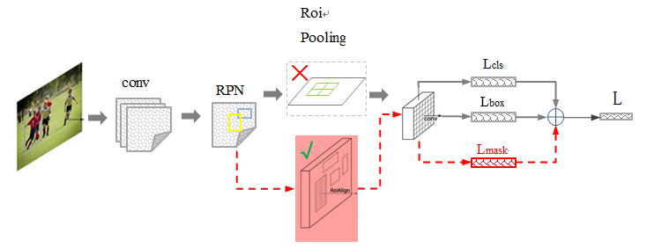
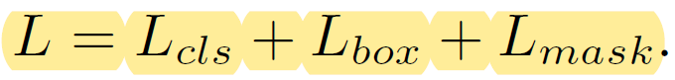
Mask R-CNN (He, ICCV 2017)
RoIAlign
Improved Convolution Network
Using RoIAlign layer to get better RoI
Added the mask prediction branch

Slide 8
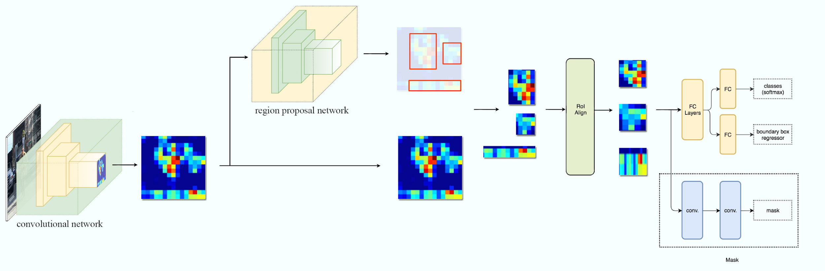
Mask R-CNN
ResNeXt+Feature Pyramid Networks(FPN)

Slide 9
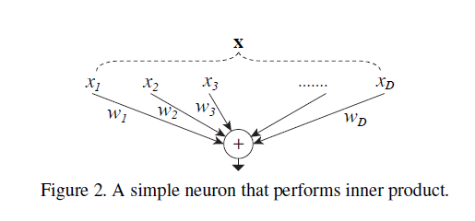
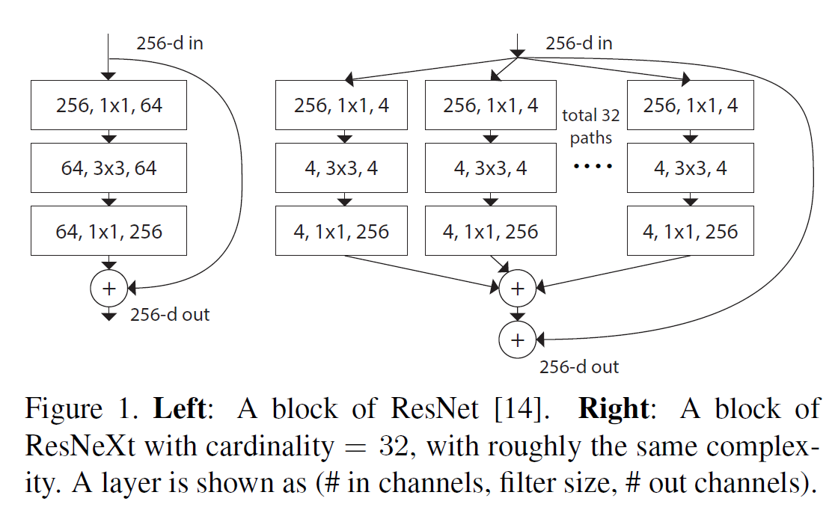
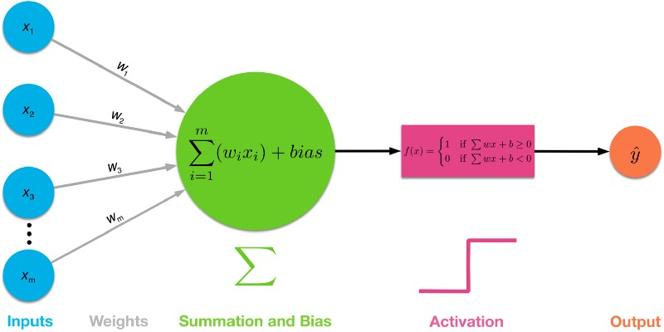
Mask R-CNN
Network in Neuron
ResNeXt (Xie, CVPR 2017)

Slide 10
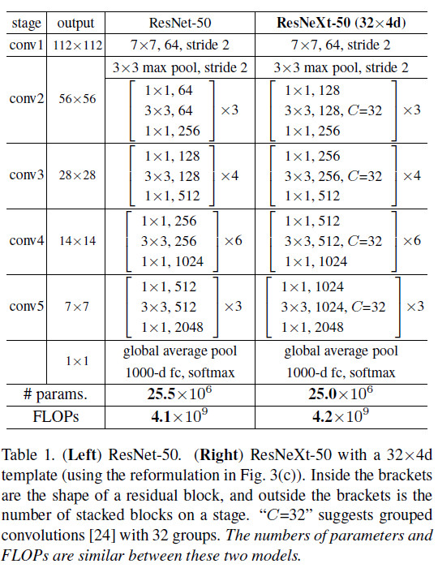
ResNeXt
With similar numbers of parameters and FLOPs, ResNeXt can get lower error rate on ImageNet
A better backbone architecture for feature extraction
Notes:
Floating-point operations per second

Slide 11
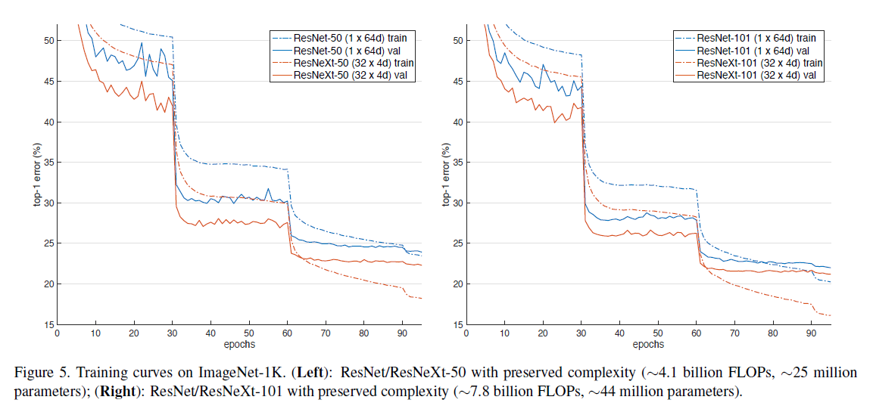
ResNeXt

Slide 12
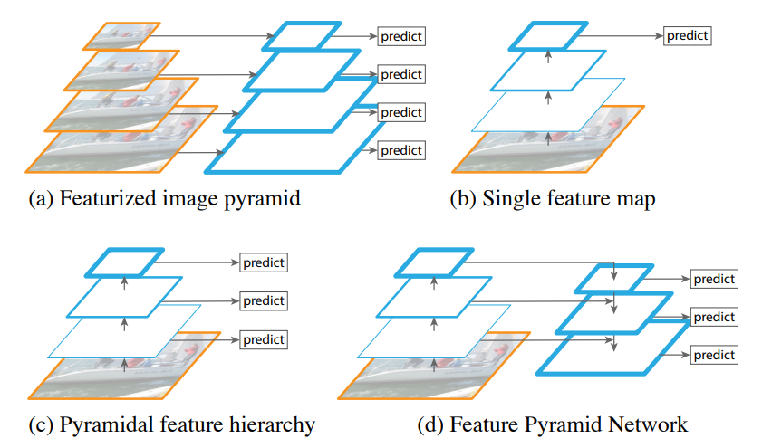
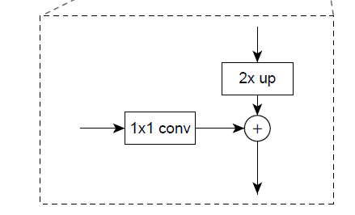
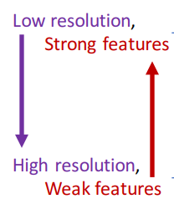
Feature Pyramid Network(FPN) (Lin, CVPR 2017)
Popular strategies for detecting objects over large scale changes
nearest neighbor upsampling for simplicity
Notes:
slow
only have 1 scale

Slide 13
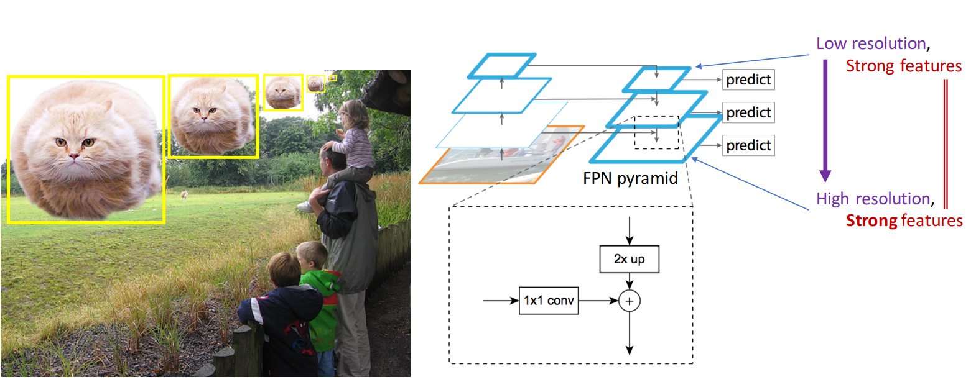
Feature Pyramid Network(FPN)

Slide 14
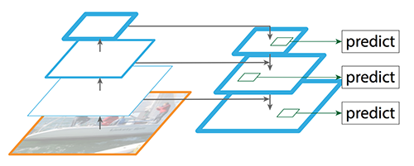
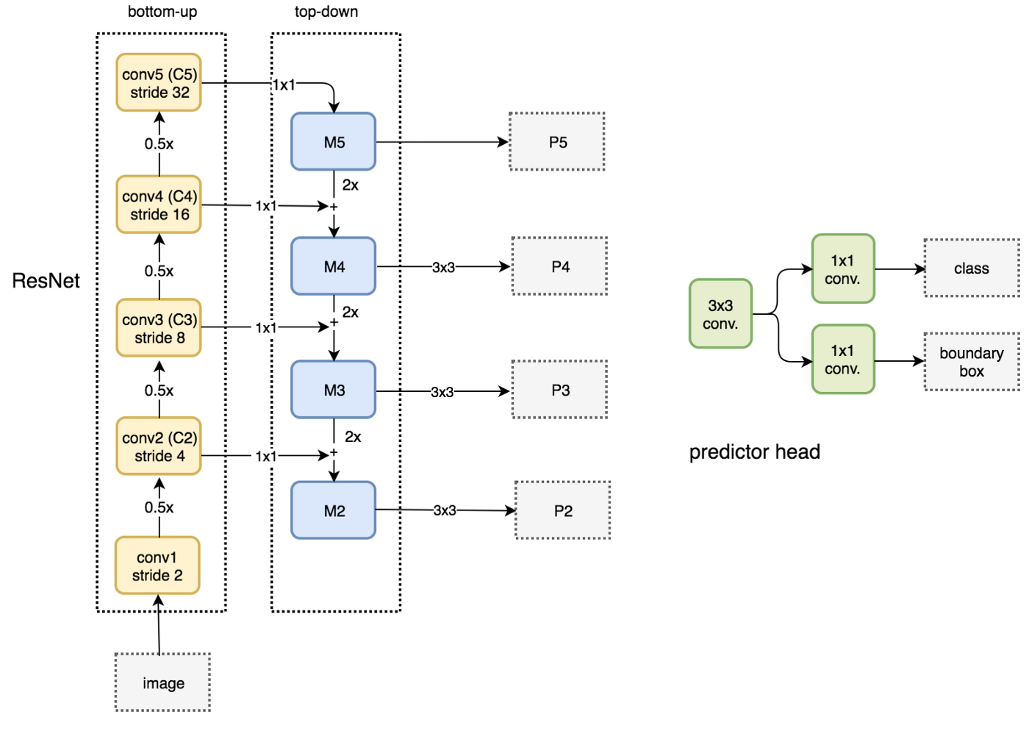
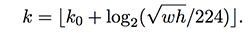
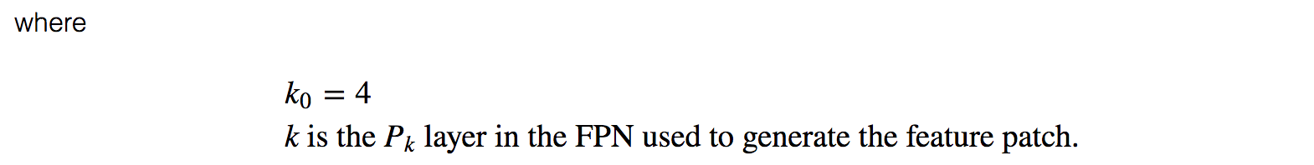
FPN
Notes:
The author sets k_0 to 4, which means that the ROI of w×h=224×224 should be cut out from P4.
Assuming the scale of the ROI is less than 224 (say 112 * 112), k = k_0-1 = 4-1 = 3, which means that it is generated from a higher resolution P_3.
In addition, the k value is rounded to prevent the result from being an integer.

Slide 15

FPN
Notes:
non-maximum suppression

Slide 16
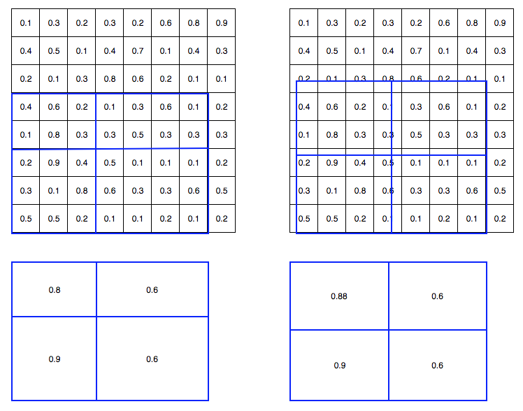
RoI Align
The cell boundaries of the target feature map are forced to realign with the boundary of the input feature maps. Therefore, each target cells may not be in the same size.
By applying interpolation, the maximum feature value on the top left is changed from 0.8 to 0.88 now.

Slide 17
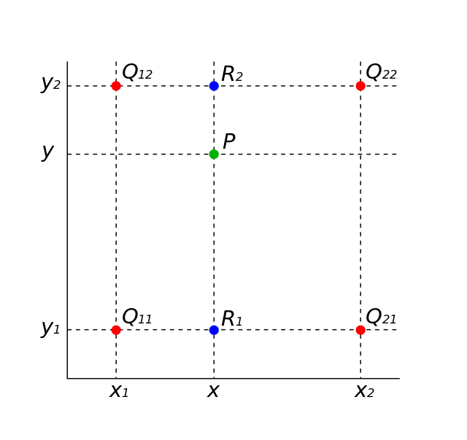
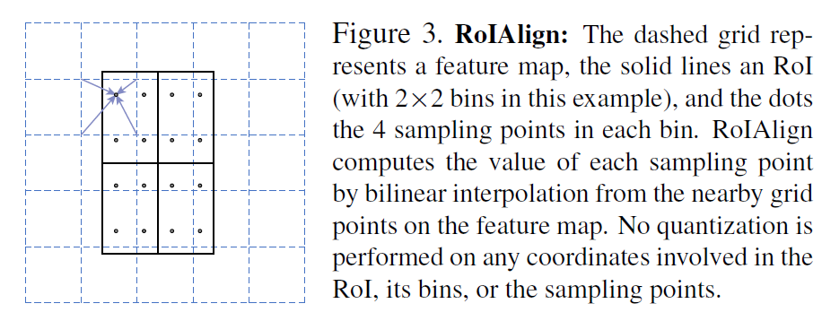
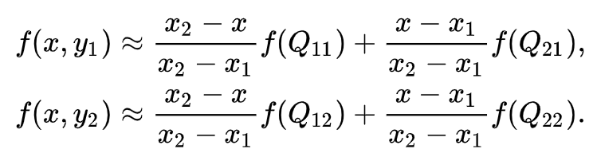
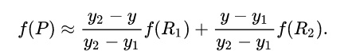
Bilinear Interpolation

Slide 18
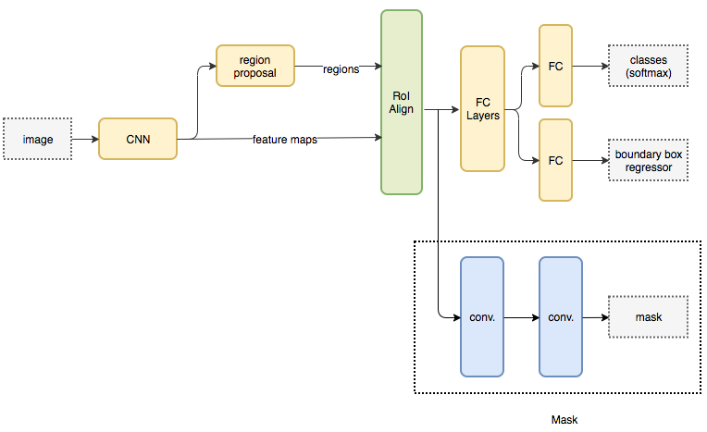
Head Architecture
Notes:
non-maximum suppression

Slide 19
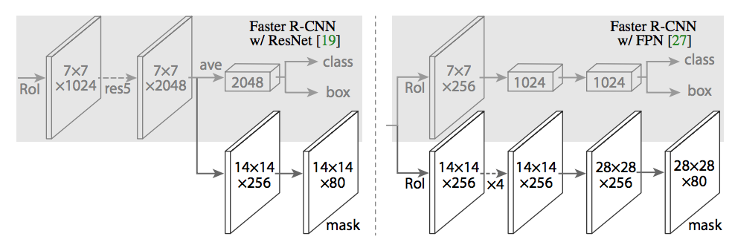
Head Architecture
We note that our mask branches have a straightforward structure. More complex designs have the potential to improve performance but are not the focus of this work.
Left: ‘res5’ denotes ResNet’s fifth stage, which for simplicity we altered so that the first conv operates on a 7x7 RoI with stride 1 (instead of 14x14 / stride 2 as in ResNet).
Right: ‘4’ denotes a stack of four consecutive convs.

Slide 20
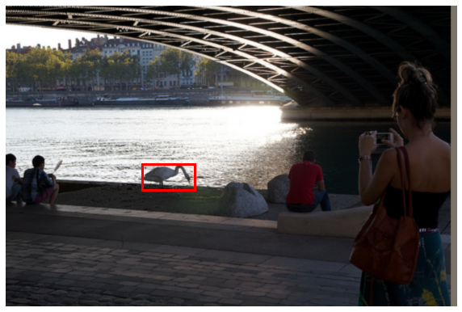
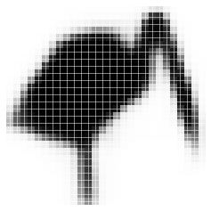


28x28 soft prediction
Resized Soft prediction
Final mask
Validation image with box detection shown in red

Slide 21
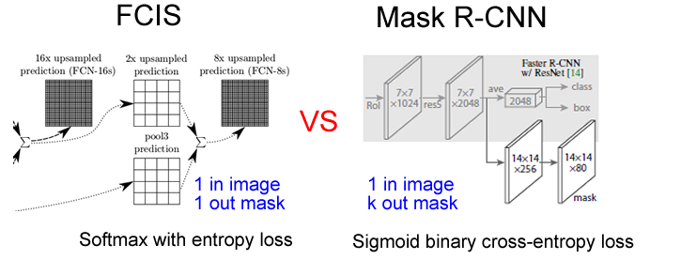
Without competition among classes

Slide 22
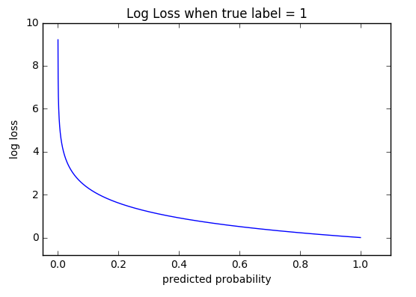
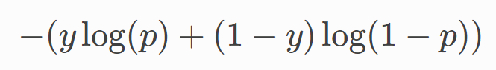
Binary Cross Entropy
In binary classification, where the number of classes M equals 2, cross-entropy can be calculated as:
log - the natural log
y - binary indicator (0 or 1) if class label cc is the correct classification for observation
p - predicted probability observation is of class
Apply a per-pixel sigmoid, and define L_mask as the average binary cross-entropy loss.
loss_mask = cross_enctropy(sigmoid(x), y)

Slide 23
Mask R-CNN
Result Analysis
From Kaiming He’s ICCV 2017 Tutorial

Slide 24
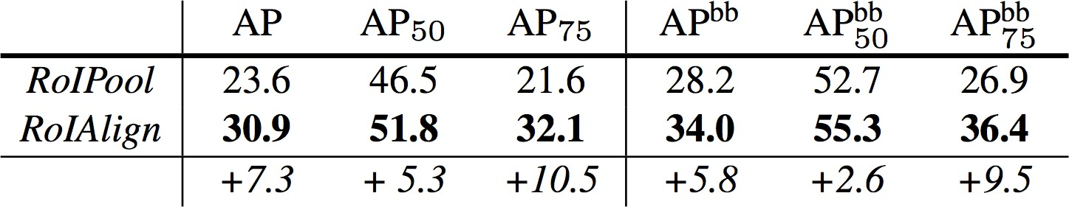
Ablation: RoIPool vs. RoIAlign
baseline: ResNet-50-Conv5 backbone, stride=32
mask AP box AP
huge gain at high IoU, in case of big stride (32)

Slide 25
Ablation: RoIPool vs. RoIAlign
baseline: ResNet-50-Conv5 backbone, stride=32
mask AP box AP
nice box AP without dilation/upsampling

Slide 26
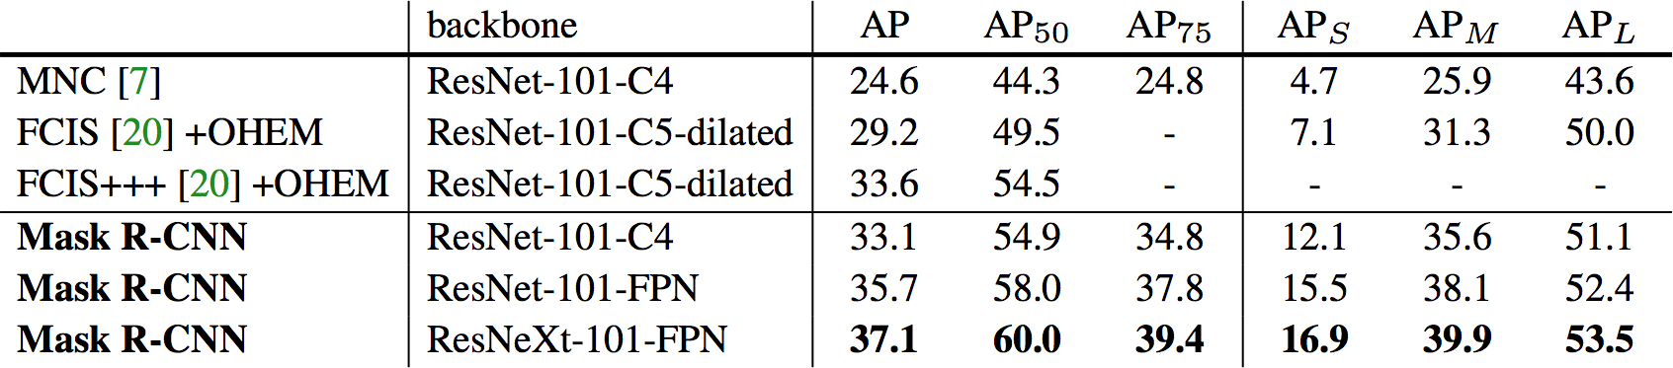
Instance Segmentation Results on COCO
2 AP better than SOTA w/ R101, without bells and whistles
200ms / img

Slide 27
Instance Segmentation Results on COCO
benefit from better features (ResNeXt [Xie et al. CVPR’17])

Slide 28
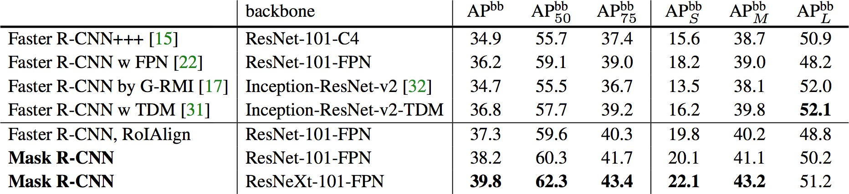
Object Detection Results on COCO
bbox detection improved by:
RoIAlign

Slide 29
Object Detection Results on COCO
bbox detection improved by:
RoIAlign
Multi-task training w/ mask

Slide 30
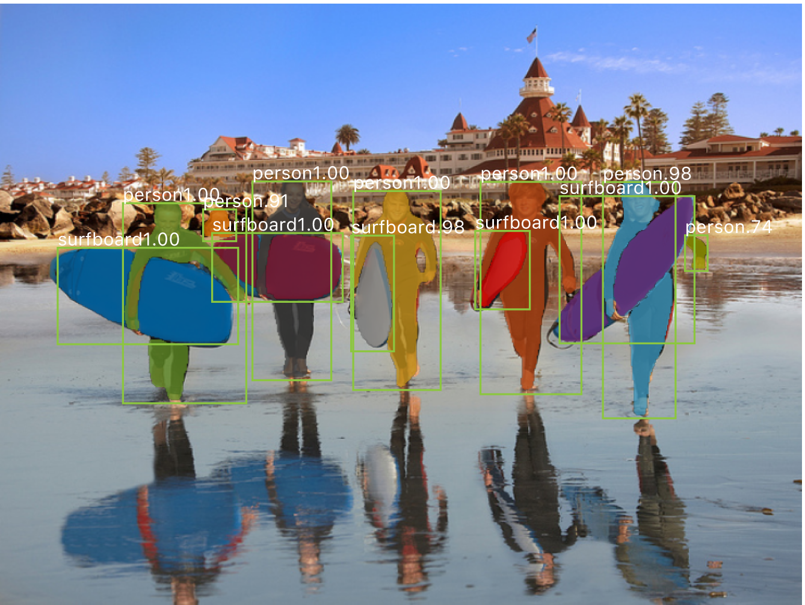
disconnected object
Mask R-CNN results on COCO

Slide 31
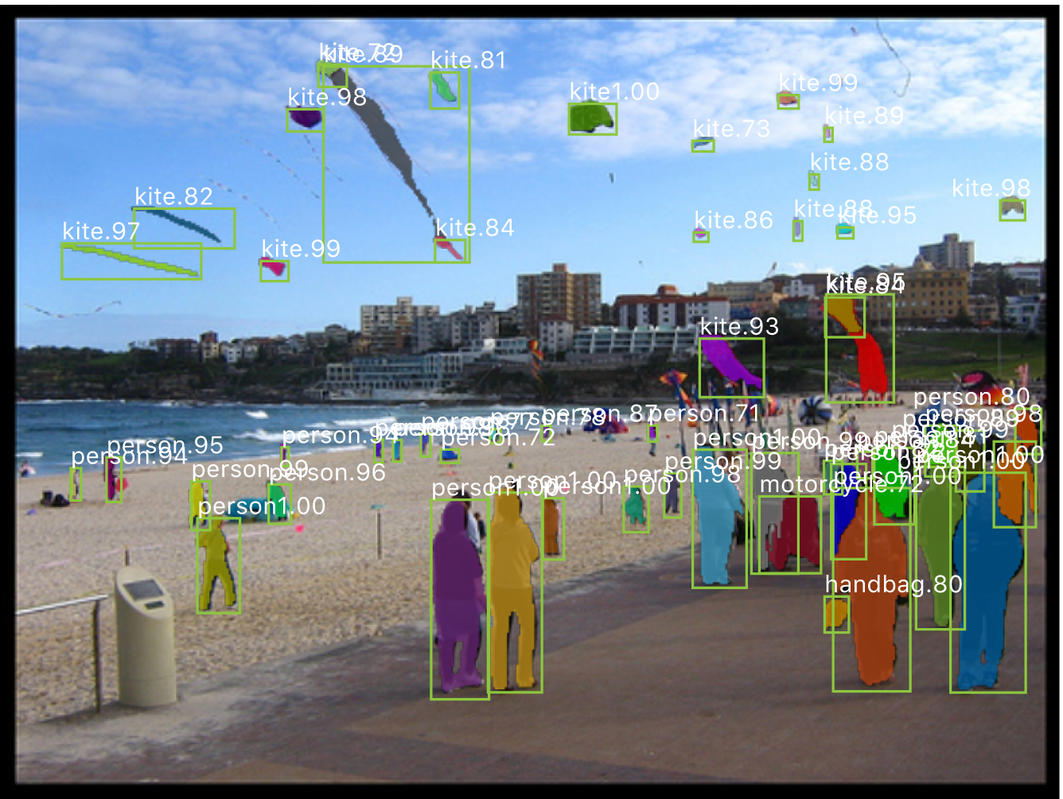
small objects
Mask R-CNN results on COCO

Slide 32
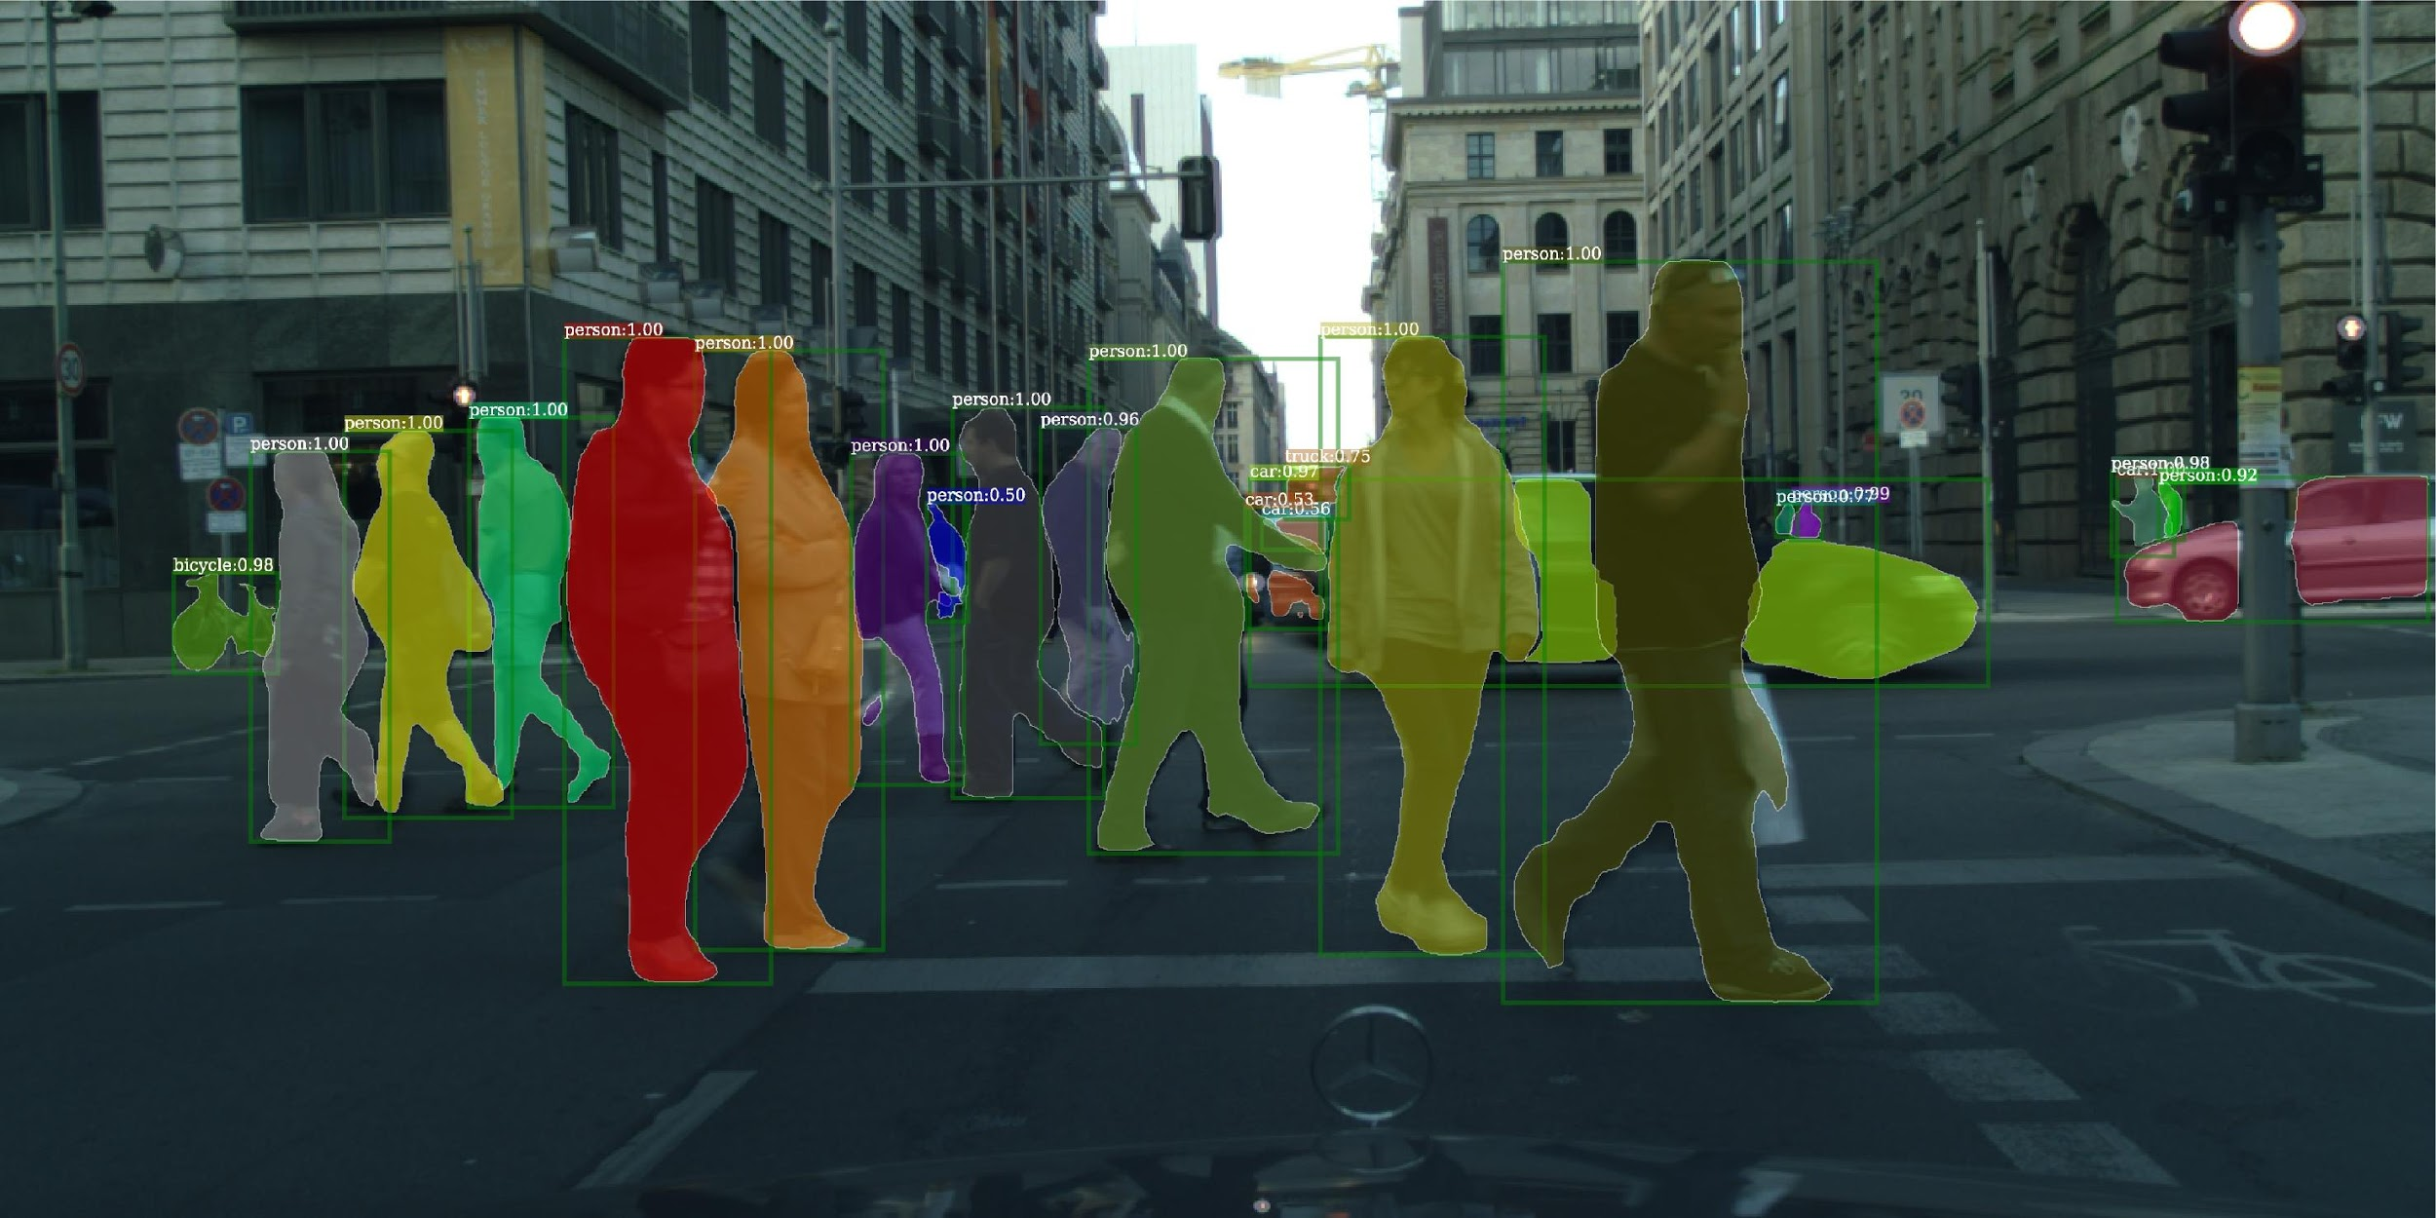
Mask R-CNN results on CityScapes

Slide 33
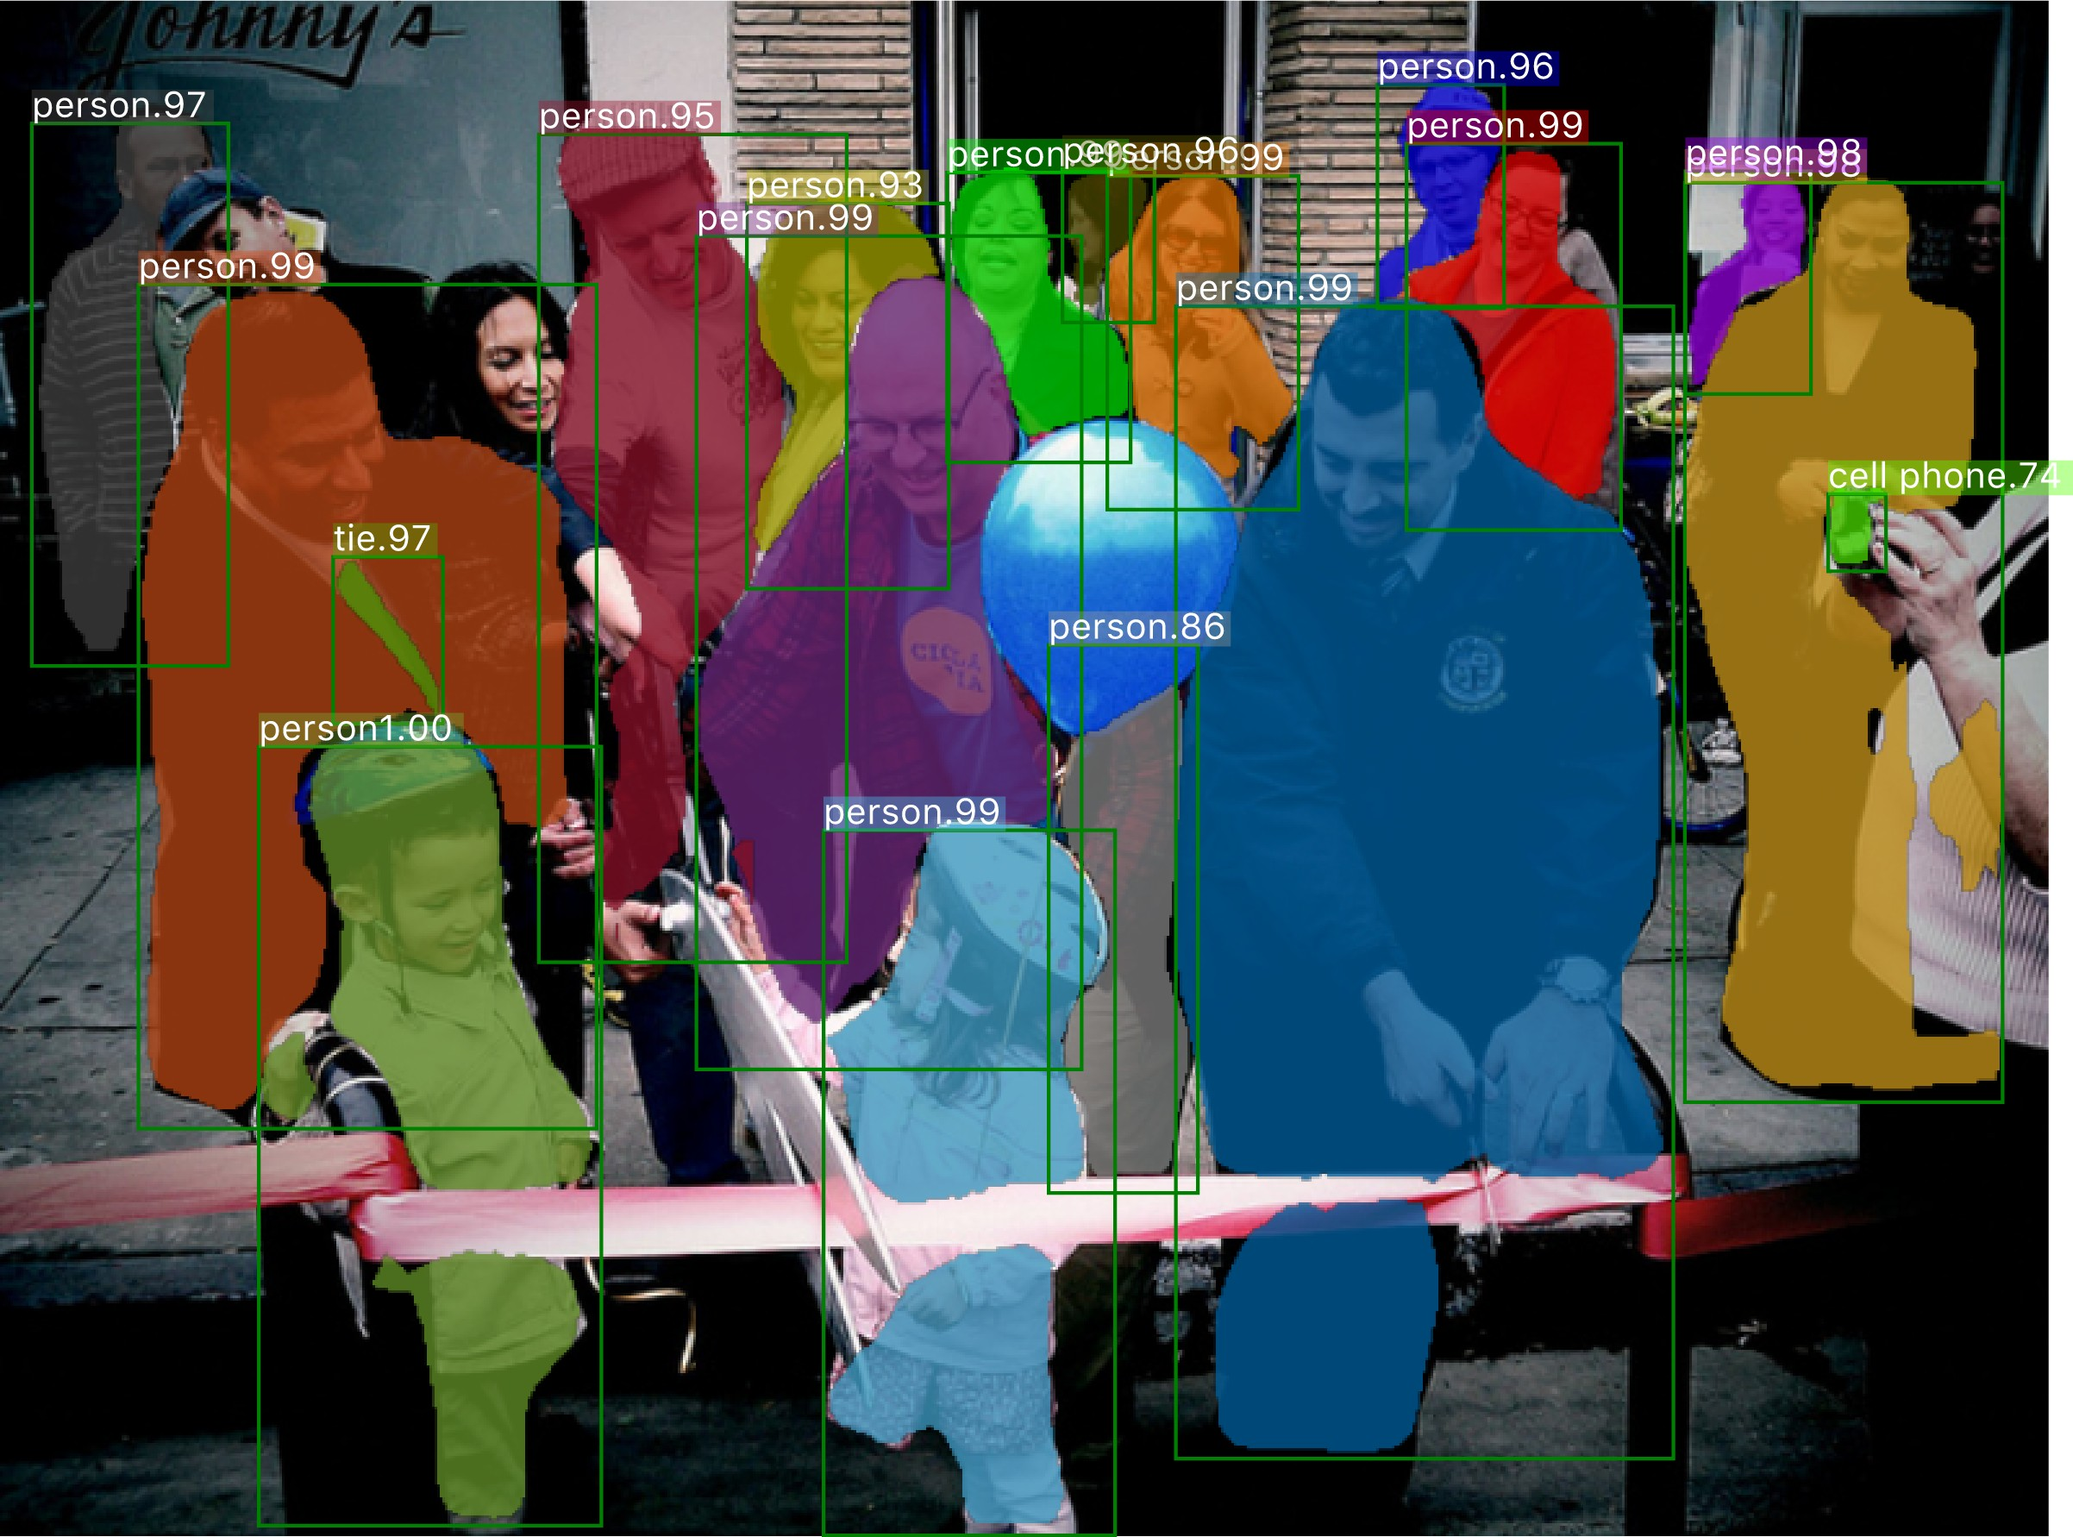
Failure case: detection/segmentation
missing
missing, false mask
Mask R-CNN results on COCO

Slide 34
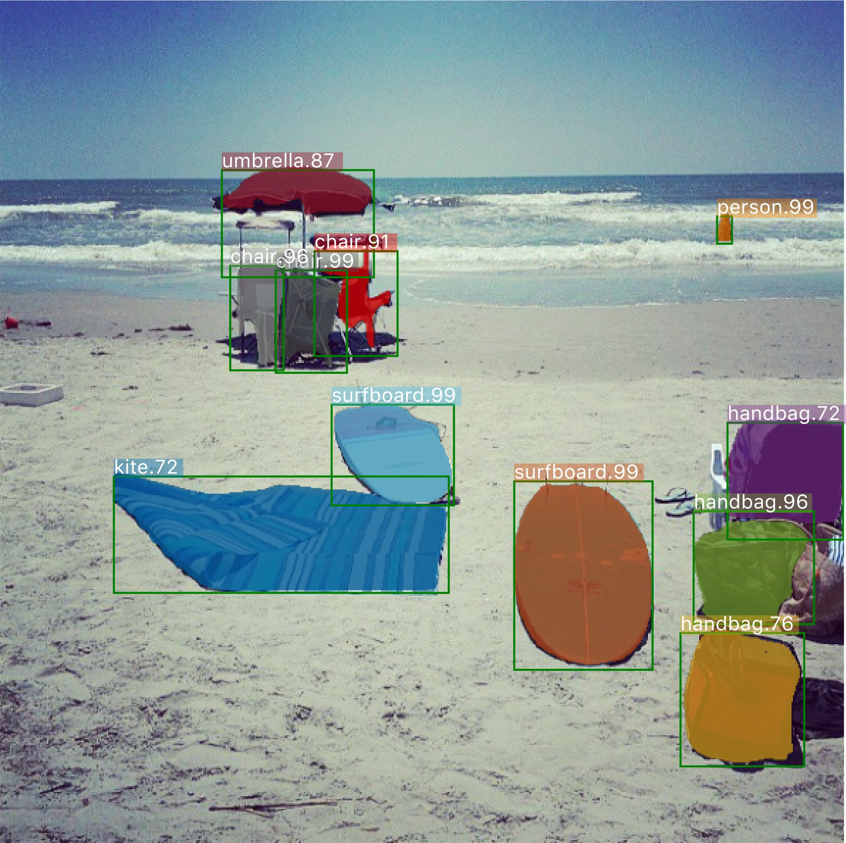
Failure case: recognition
blanket
not a kite
Mask R-CNN results on COCO

Slide 35
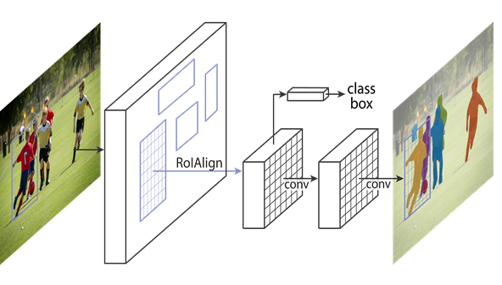
Conclusion
Mask R-CNN：
Good Speed
Good Accuracy
Intuitive
Easy to use

Slide 36
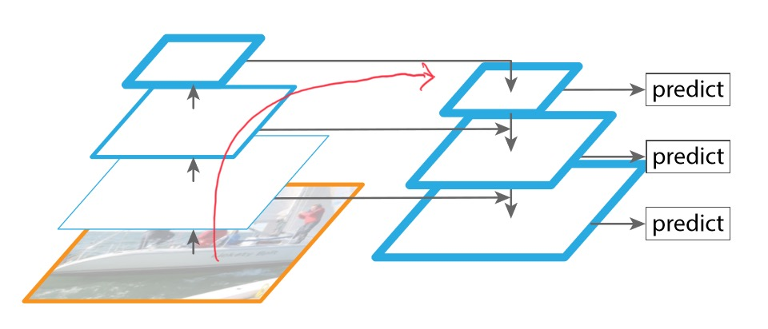
Improve Mask R-CNN
A long path from low level structure to topmost features,
increasing difficulty to access accurate localization information
Each proposal is predicted from one feature level
Mask prediction is made on a single view(FCN)
Notes:
State-of-art Mask R-CNN is good, but there are still some aspects which can be improved.
First, the information propagation. features in low levels are helpful for large instance identiﬁcation. But from here we can see there is a long path from low-level structure to topmost features, increasing difﬁculty to access accurate localization information.
Second, each proposal is predicted based on feature grids pooled from one feature level. However, information discarded in other levels may be helpful for ﬁnal prediction
Finally, mask prediction is made on a single view, losing the chance to gather more diverse information.

Slide 37
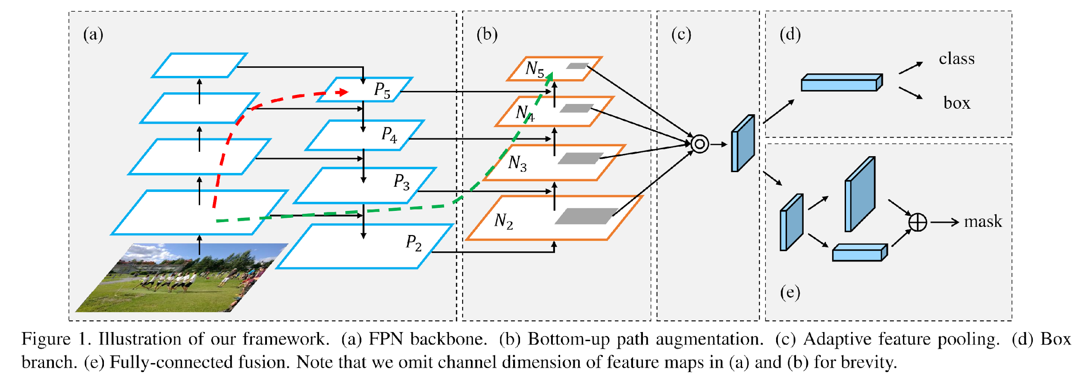
Path Aggregation Network (PANet) (Liu, CVPR 2018)
Based on Mask R-CNN
Bottom-up path augmentation.
Adaptive feature pooling
Fully-connected fusion
Notes:
First, to shorten information path and enhance feature pyramid with accurate localization signals existing in low-levels,we add a bottom-up path augmentation,
Second, to recover broken information path between each proposal and all feature levels, we develop adaptive feature pooling.
Finally, to capture different views of each proposal, we augment mask prediction with tiny fully-connected(fc) layers, which keeps more global information, possess complementary properties to FCN originally used by Mask R-CNN. By fusing predictions from these two views, information diversity increases and produce better quality masks.

Slide 38
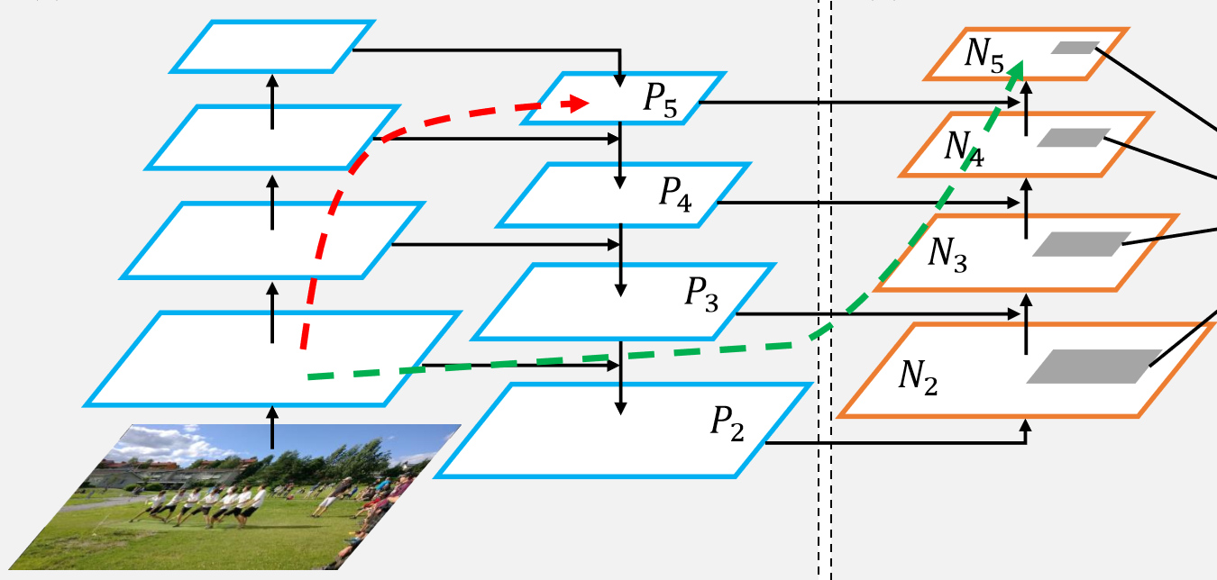
PANet: Bottom-up path augmentation
Motivation
top-down: higher resolution features, semantically stronger
Bottom-up: more accurately localized
P5: long path(dashed red, 100+layers) lose localization information
N5: shortcut(dashed green, < 10 layers)
Notes:
In FPN, A top-down path propagate semantically strong features
Our framework further enhances the localization capability of the entire feature hierarchy by propagating strong responses of low-level patterns. The low-level feature is a strong indicator to accurately localize instances.
To this end, we build a path with clean lateral connections from the low level to top ones. The dashed green path to N5, which consists of less than 10 layers. But the dashed red long path pass through even 100+ layers to P5
The N5 keeps more localization information than P5

Slide 39
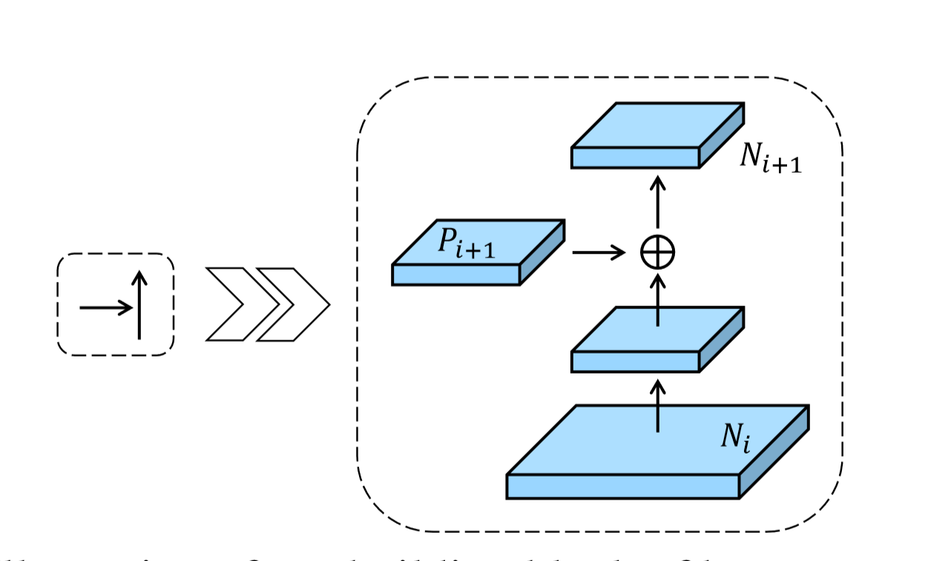
PANet: Bottom-up path augmentation
Structure
N2 = P2
Ni goes through 3*3 conv layers with stride 2
Notes:
They follow FPN to deﬁne that layers producing feature maps with the same spatial size are in the same network stage.
The augmented path starts from the lowest level P2 and gradually approaches P5.
Here they use {N2,N3,N4,N5} to denote newly generated feature maps corresponding to {P2,P3,P4,P5}. Note that N2 is simply P2, without any processing.
As shown in right image, each building block takes a higher resolution feature map Ni and a coarser map Pi+1 through lateral connection and generates the new feature map Ni+1.
Ni ﬁrst goes through a 3 × 3 convolutional layer with stride 2 to reduce the spatial size, then each element of Pi+1 and downsampled map are added through lateral connection.
In these building blocks, we consistently use channel 256 of feature maps. All convolutional layers are followed by a ReLU.

Slide 40
PANet: Adaptive feature pooling
Motivation:
Small proposals to low feature level
Large proposals to high feature level
Two proposals with 10-pixel difference to different levels
Good but not optimal
Notes:
Further, importance of features may not be strongly correlated to the levels they belong to.
High-level features are generated with large receptive ﬁelds and capture richer context information. Allowing small proposals to access these features better exploits useful context information for prediction.
Similarly, low-level features are with many ﬁne details and high localization accuracy. Making large proposals access them is obviously beneﬁcial.

Slide 41
PANet: Adaptive feature pooling
For each proposal fuse pooling features from all levels
Small proposal get context info for prediction from high level
Large proposal get details and localization accuracy from low level
Notes:
With these thoughts, we propose pooling features from all levels for each proposal and fusing them for following prediction.
We use max operation to fuse features from different levels, which lets network select element-wise useful information.

Slide 42
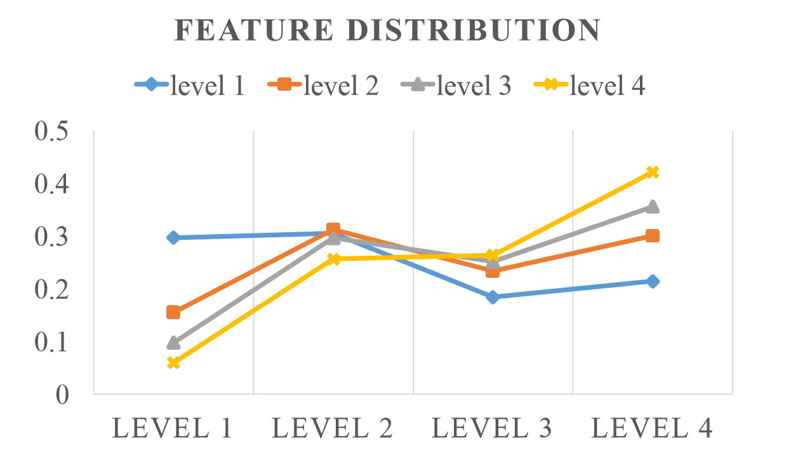
PANet: Adaptive feature pooling
Ratio of features pooled from different levels
Blue: small proposal, 70% features from higher level
Yellow: large proposal, 50% features from lower level
Notes:
We now analyze the ratio of features pooled from different levels with adaptive feature pooling.
They cluster proposals into four classes based on the levels they were assigned to originally in FPN. For each set of proposals, we calculate the ratio of features selected from different levels. In notation, levels 1 − 4 represent low-to-high levels
the blue line represents small proposals that were assigned to level 1 originally in FPN. Surprisingly, nearly 70% of features are from other higher levels. Again, 50%+ of the features are pooled from other lower levels.
This observation clearly indicates that features in multiple levels together are helpful for accurate prediction.

Slide 43
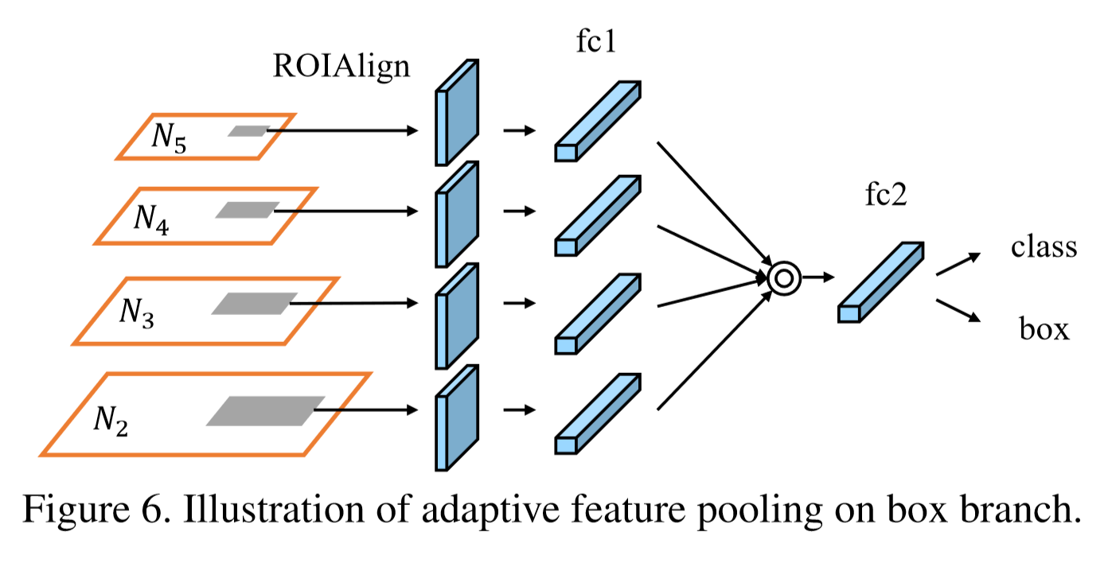
PANet: Adaptive feature pooling
Implementation Structure
Map each proposal to different level
ROI Align is used to pool feature grids from each level
Element-wise max or sum fusion operation
Notes:
For example, there are two fc layers in the box branch in FPN. We apply the fusion operation after the ﬁrst layer.
Since four consecutive convolutional layers are used in mask prediction branch in MaskR-CNN, we place fusion operation between the ﬁrst and second convolutional layers.

Slide 44
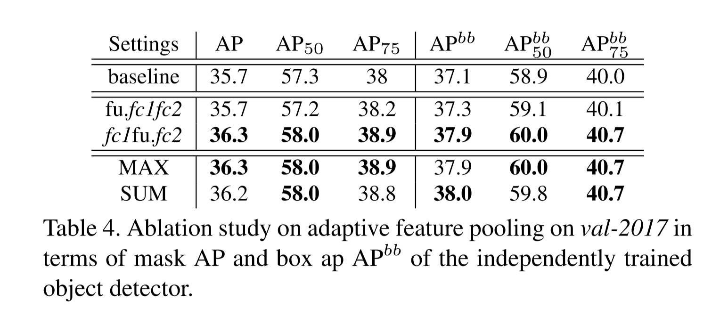
PANet: Adaptive feature pooling
Ablation: where to put fusion operation?
Fu fc1 fc2
fc1 fu fc2
Notes:
conduct ablation studies
We place it either between ROI Align and fc1, represented by “fu.fc1fc2” or between fc1 and fc2, represented by “fc1fu.fc2”
Similar settings are also applied to mask prediction branch. For feature fusing, max and sum operations are tested.
Finally, We use max as fusion operation and use it behind the ﬁrst parameter layer in our framework

Slide 45
PANet: Fully-connected Fusion
Motivation:
FCN: gives prediction based on a local receptive field
fc: larger vision, location sensitive
Fuse them!
Notes:
We note fc layers yield different properties compared with FCN where the latter gives prediction at each pixel based on a local receptive ﬁeld and parameters are shared at different spatial locations.
Contrarily, fc layers are location sensitive since predictions at different spatial locations are achieved by varying sets of parameters. So they have the ability to adapt to different spatial locations. It is helpful to differentiate instances and recognize separate parts belonging to the same object.

Slide 46
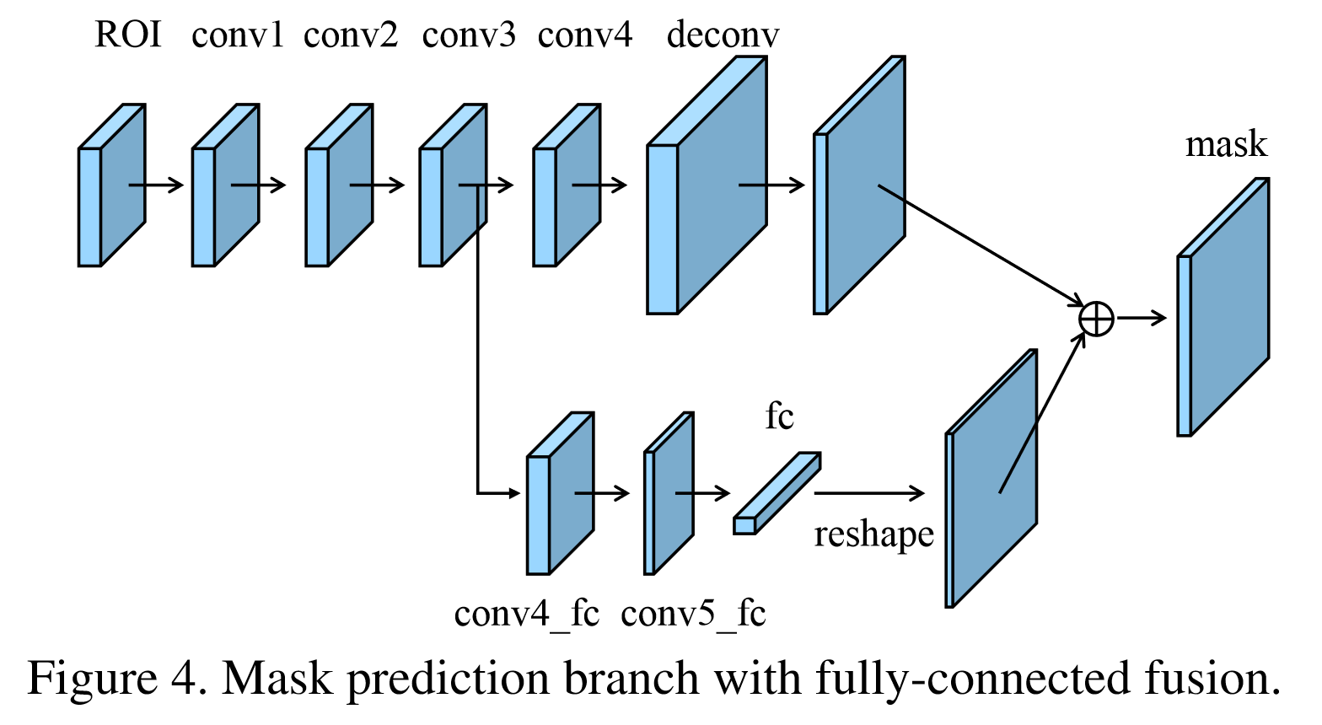
PANet: Fully-connected Fusion
FCN layer:
4 conv layers with 256 3*3 filters
Deconv with factor 2
fc layer:
First layer, 256 3*3 filters
Second layer, 128 3*3 filters
Notes:
Each convolutional layer consists of 256 3×3 ﬁlters and the deconvolutional layer up-samples feature with factor 2.
It predicts a binary pixel-wise mask for each class independently to decouple segmentation and classiﬁcation, similar to that of Mask R-CNN.
We further create a short path from layer conv3 to a fc layer. There are two 3×3 convolutional layers where the second shrinks channels to half to reduce computational overhead.
The mask size we use is 28×28 so that the fc layer produces a 784×1×1 vector. This vector is reshaped to the same spatial size as the mask predicted by FCN.
Using only one fc layer, instead of multiple of them, for ﬁnal prediction prevents the issue of collapsing the hidden spatial feature map into a short feature vector, which loses spatial information

Slide 47

PANet: Fully-connected Fusion
Ablation: where to start fc branch and how to fuse predictions?
“conv3” and “sum” win!!
Notes:
We consider two aspects, i.e., the layer to start the new branch and the way to fuse predictions from the new branch and FCN.
We experiment with creating new paths from conv2, conv3 and conv4, respectively. “max”, “sum” and “product” operations are used for fusion
baseline: with bottom-up path augmentation and adaptive feature pooling
They clearly show that starting from conv3 and taking sum for fusion produces the best results.

Slide 48

PANet: Experiments
Mask AP
Notes:
We report performance of our PANet on test-dev for comparison, with and without multi-scale training.
our PANet with ResNet-50 trained on multi-scale images and tested on single-scale images already outperforms Mask R-CNN and Champion in 2016

Slide 49

PANet: Experiments
Notes:
Our ablation study from the baseline gradually to all components incorporated is conducted on val-2017 subset and is shown here. ResNet-50 is our initial model. We report performance in terms of maskAP, boxap APbb of an independently trained object detector and boxapAPbbM of box branch trained in the multi-task fashion.
With or without adaptive feature pooling, bottom-up path augmentation consistently improves mask AP and box ap APbb by more than 0.6 and 0.9 respectively. The improvement on instances with large scale is most signiﬁcant. This veriﬁes usefulness of information from lower feature levels.
With or without bottom up path augmentation,adaptive feature pooling consistently improves performance. The performance in all scales generally improves.
Fully-connected fusion aims at predicting masks with better quality. It yields 0.7 improvement in terms of mask AP. It is general for instances at all scales.
With all these components in PANet, improvement on mask AP is 4.4 over baselines. Box ap APbb of independently trained object detector increases 4.2. Small- and medium-size instances contribute most

Slide 50

PANet: Experiments

Slide 51
There are two categories of methods
for instance segmentation.
Proposal-free methods: cluster pixels into instances based on semantic segmentation results (SGN)

Slide 52

Affinity Derivation and Graph Merge
for Instance Segmentation
(GMIS)
Y. Liu, S. Yang, B. Li, W. Zhou, J. Xu, H. Li and Y. Lu
A novel proposal-free method

Slide 53

GMIS
Structure
Step 1
Step 2

Slide 54


GMIS
Structure
Semantic branch: obtain class information
Step 1
Deeplabv3
Instance branch: obtain pixel affinity information
Deeplabv3

Slide 55

GMIS
Structure
Semantic branch: obtain class information
Step 1
Deeplabv3
Instance branch: obtain pixel affinity information
Deeplabv3

Slide 56

GMIS
Structure
Semantic branch: obtain class information
Step 1
Deeplabv3
Instance branch: obtain pixel affinity information
Deeplabv3

Slide 57

GMIS
Structure
Graph merge algorithm (implemented in C++):
generate the pixel-level masks for each instance
Step 2

Slide 58

GMIS
Structure

Slide 59

GMIS
Experimental Evaluation
Dataset | Evaluation metric
Cityscapes | AP (calculated by the mean of IOU threshold from 0.5 to 0.95 with the step of 0.05)

Slide 60

GMIS
Implementation tricks
Excluding Background
Pixel Affinity Refinement
only look for connected areas of foreground pixels as ROIs
Semantic Class Partition
combine classes in each set as a superclass to weaken the influence from the semantic term

Slide 61

GMIS
Experimental Evaluation

Slide 62

GMIS
Experimental Evaluation

Slide 63
GMIS
Strength
a novel proposal-free method
beat Mask R-CNN on Cityscapes dataset by 1.1 point AP
use only Cityscapes training data

Slide 64
Github repo
Mask R-CNN (Caffe2) https://github.com/facebookresearch/Detectron
Mask R-CNN (Tensorflow) https://github.com/matterport/Mask_RCNN
PANet (Pytorch) https://github.com/ShuLiu1993/PANet
GMIS (Tensorflow) https://github.com/xck36/GMIS

